Slide 1
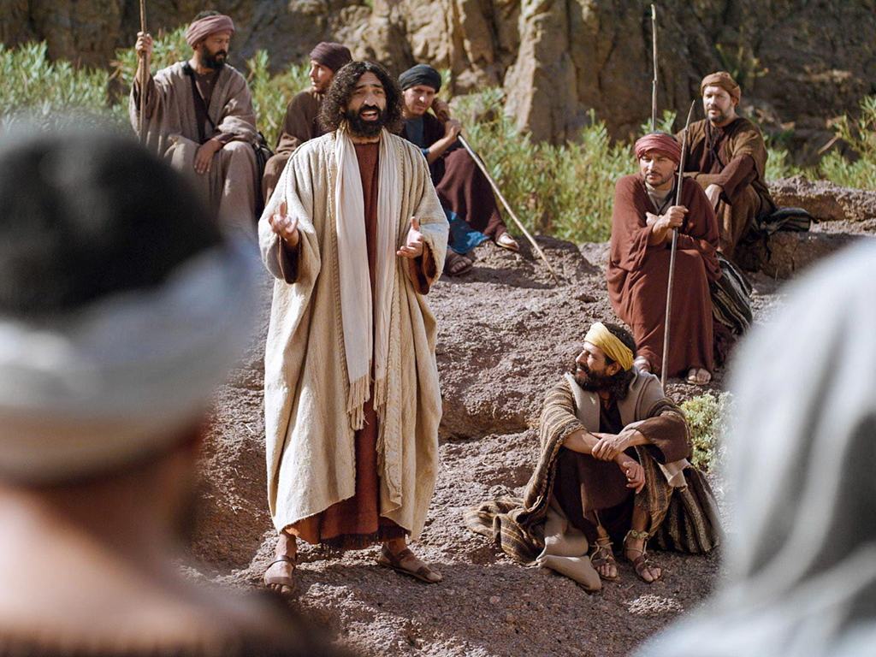
Image © Big Book Media / distributed by FreeBibleImages.org
John 12.37-50

Slide 2
John 12.37-38 NET: Although Jesus had performed so many miraculous signs before them, they still refused to believe in him, so that the word of Isaiah the prophet would be fulfilled. He said, “Lord, who has believed our message, and to whom has the arm of the Lord been revealed?”
Isaiah 53.1

Slide 3
John 12.39-40: For this reason they could not believe, because again Isaiah said, “He has blinded their eyes and hardened their heart, [‘]so that they would not see with their eyes and understand with their heart, and [thus] turn to me, and I would heal them.[’]”
Isaiah 6.10
repent

Slide 4
John 12.39-40: For this reason they could not believe, because again Isaiah said, “He has blinded their eyes and hardened their heart, [‘]so that they would not see with their eyes and understand with their heart, and [thus] turn to me, and I would heal them.[’]”
Isaiah 6.10
Greek στρέφω [STREH-foe]
Hebrewשׁוּב [SHOOV] turn/return
repent

Slide 5
John 12.37-38: Human Condition
… they still refused to believe in him
… who has believed our message…?
John 12.39-40: God’s Participation
…He has blinded their eyes
and hardened their heart…

Slide 6
John 12.41: Isaiah said these things because he saw Christ's glory, and spoke about him.

Slide 7
John 12.42-43: Nevertheless, even among the rulers many believed in him, but because of the Pharisees they would not confess Jesus to be the Christ, so that they would not be put out of the synagogue. For they loved praise from men more than praise from God.
John used the aorist participle of this verb when he was non-committal about the genuineness of faith.

Slide 8
John 12.44-46: But Jesus shouted out, “The one who believes in me does not believe in me, but in the one who sent me, and the one who sees me sees the one who sent me. I have come as a light into the world, so that everyone who believes in me should not remain in darkness.”

Slide 9
John 12.44-46: But Jesus shouted out, “The one who believes in me does not believe in me, but in the one who sent me, and the one who sees me sees the one who sent me. I have come as a light into the world, so that everyone who believes in me should not remain in darkness.”
John used the present participle of this verb when he was affirming the genuineness of faith.

Slide 10
John 12.47-48: “If anyone hears my words and does not obey them, I do not judge him. For I have not come to judge the world, but to save the world. The one who rejects me and does not accept my words has a judge; the word I have spoken will judge him at the last day.”
Verb κρίνω [KRIH-no] =
to judge as in give a legal decision
or to judge as in condemn

Slide 11
John 12.49-50: “For I have not spoken from my own authority, but the Father himself who sent me has commanded me what I should say and what I should speak. And I know that his command-ment is eternal life. Thus the things I say, I say just as the Father has told me.”

Slide 12
Image © Big Book Media / distributed by FreeBibleImages.org
John 12.37-50

